Slide 1
4CeeD MNTL Workshop
Use of 4CeeD Services by Semiconductor Researchers
Patrick Su (psu8@Illinois.edu)
Robert Kaufman (rbkaufm2@Illinois.edu)
Steve Konstanty (stevek@Illinois.edu)
March 29th, 2019

Slide 2
Workshop Outline
What is 4CeeD?
New and Improved
Exploring Jupyter Integration
Live Demo
Looking Forward to SENSELET
Questions and Feedback

Slide 3
Workshop Outline
What is 4CeeD?
Organization (Collections and Datasets)
Collaboration (Spaces and Comments)
Data Collection (Templates and Extractors)
New and Improved
Exploring Jupyter Integration
Live Demo
Looking Forward to SENSELET
Questions and Feedback

Slide 4
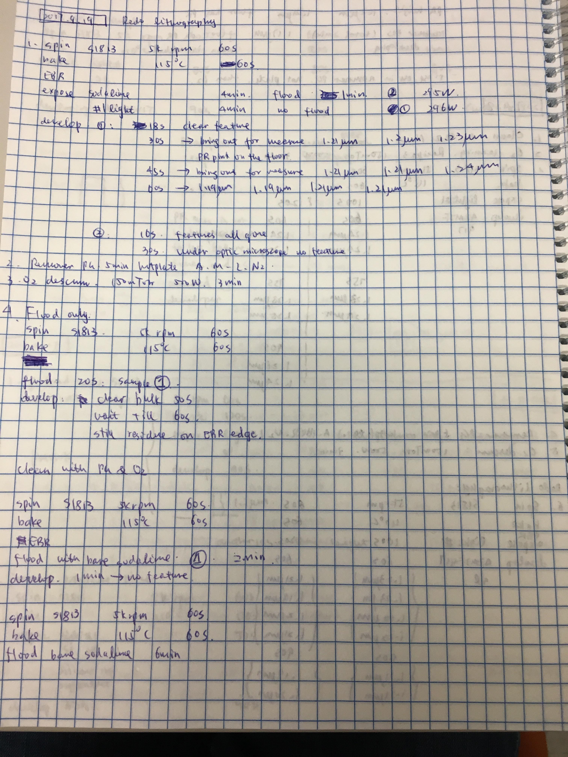
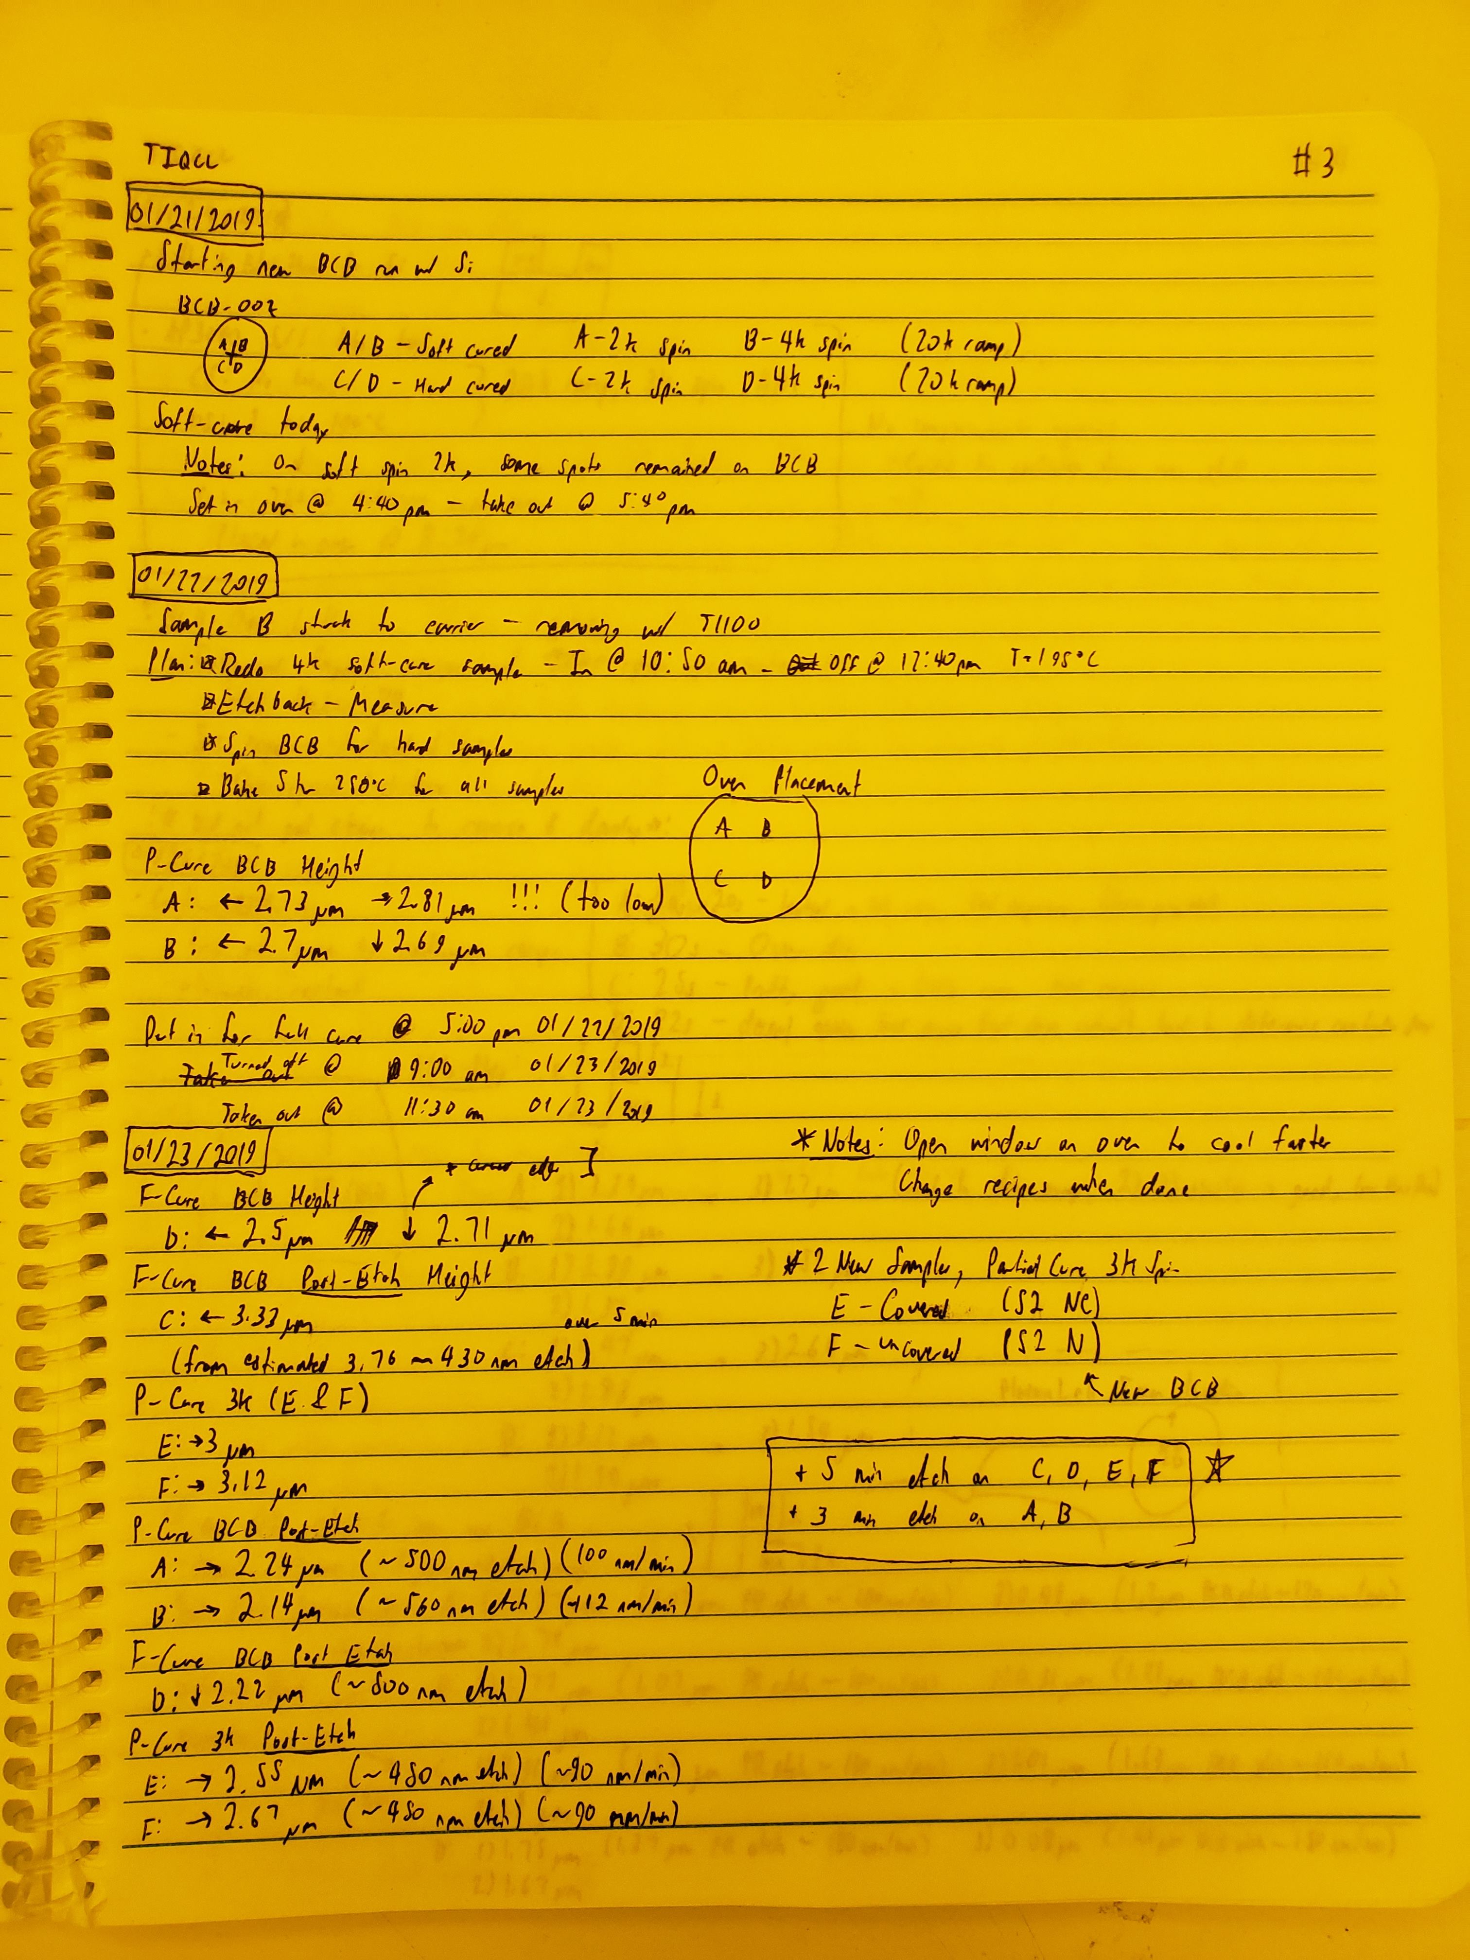
What is 4CeeD?
Created to digitize/archive fabrication data and processes
Kanuo Chen
Rob Kaufman
Notes:
When I’m finding data or looking at my groupmate’s notebooks
- Either illegible or unsearchable
- Really only understandable to the person who wrote them
- Called a “Notebook” and not a “Textbook”

Slide 5
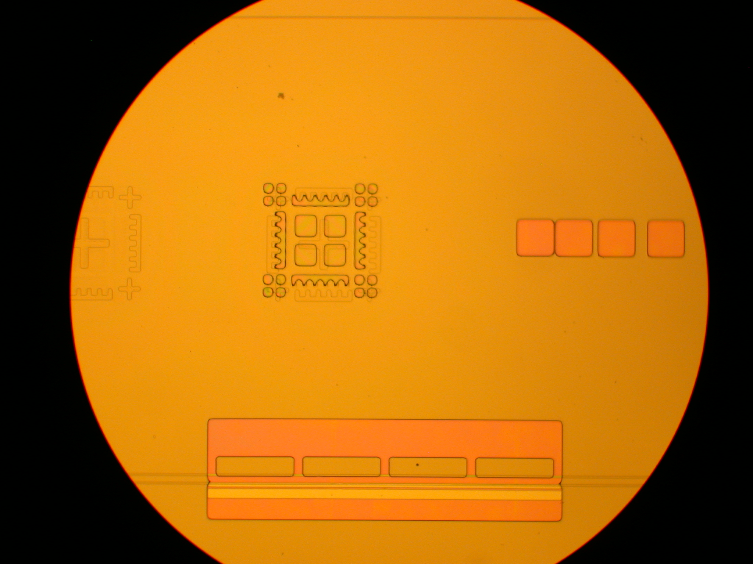
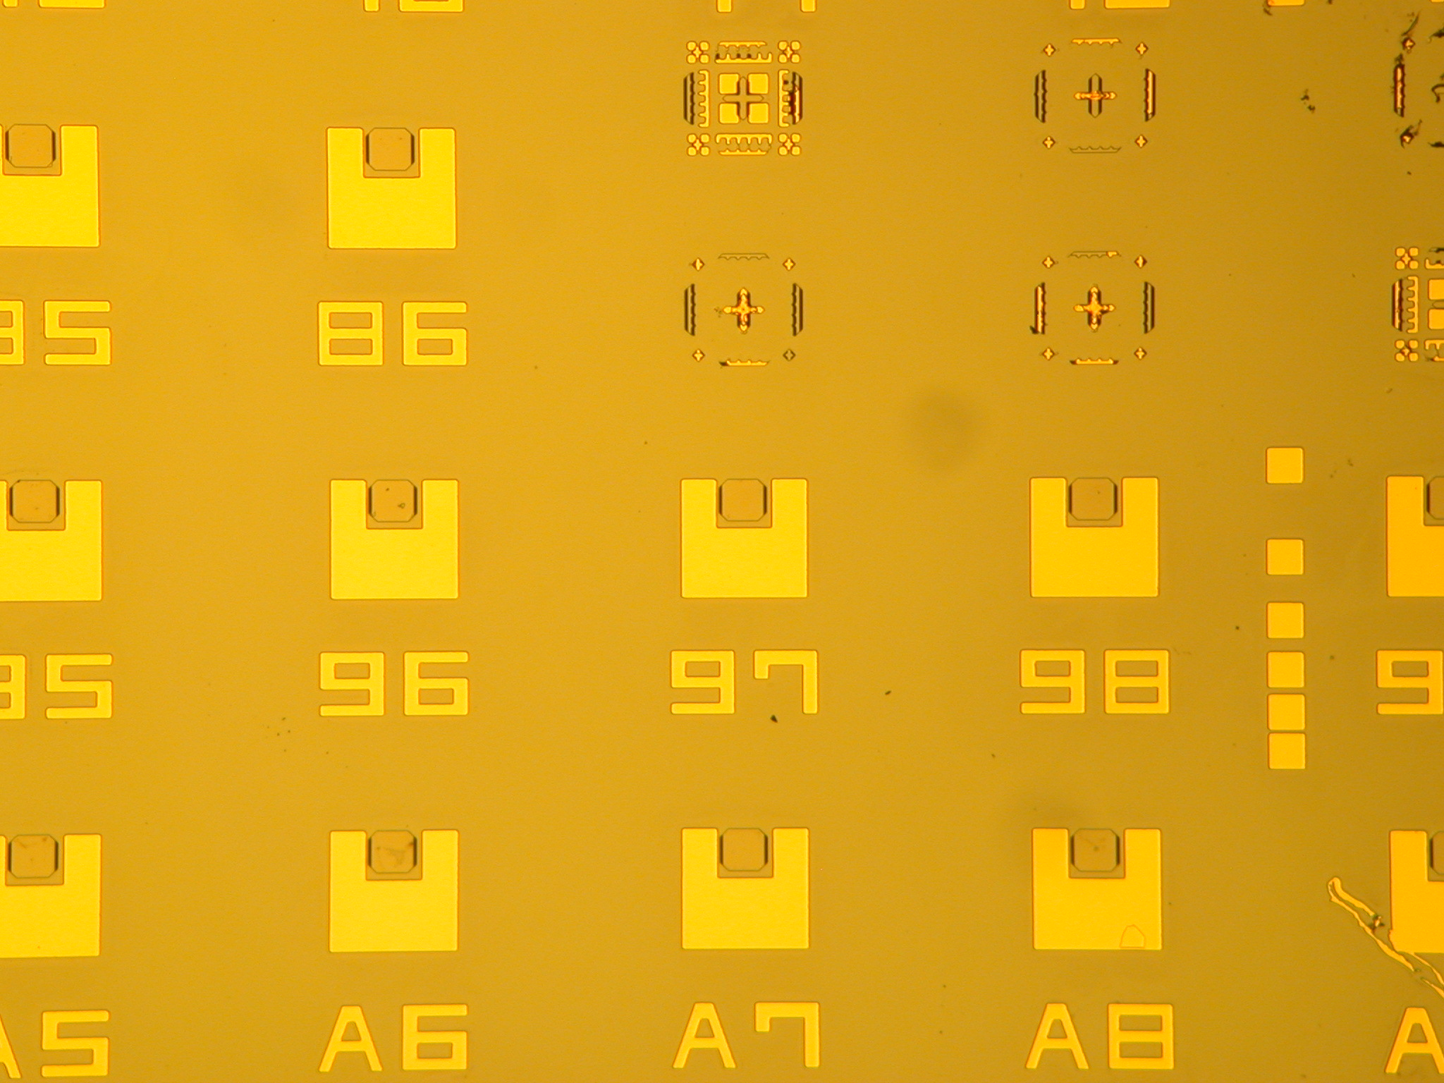
What is 4CeeD? Robust Data Organization
“Spaces”, “Collections”, and “Datasets”
4CeeD Hierarchy
Space (Projects)
Collections (Device Lots)
Datasets (Processes)
Notes:
When I’m finding data or looking at my groupmate’s notebooks
- Either illegible or unsearchable
- Really only understandable to the person who wrote them
- Called a “Notebook” and not a “Textbook”

Slide 6
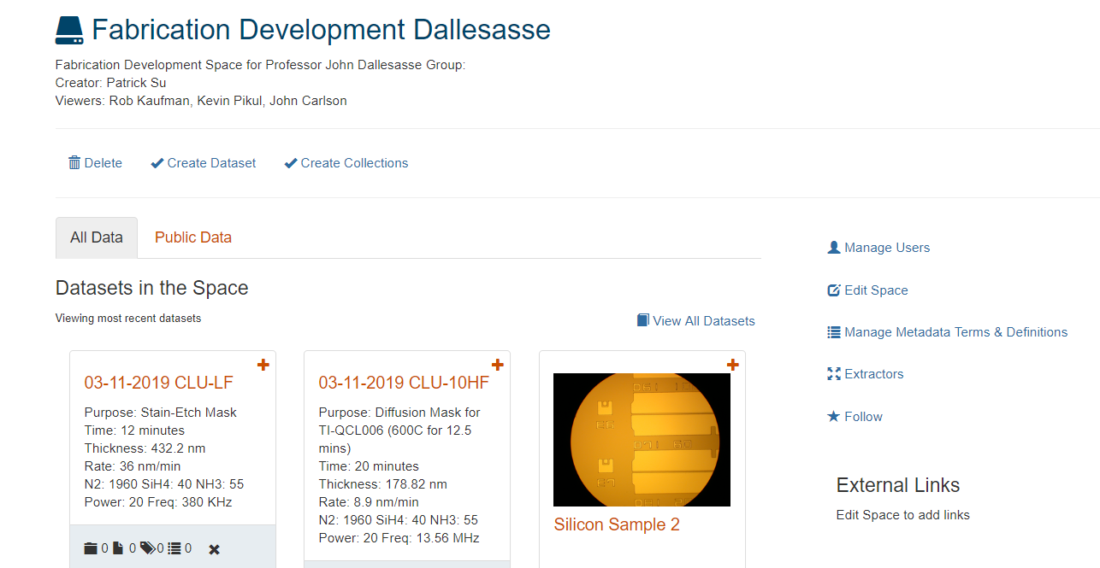
What is 4CeeD? Effective Collaboration
Shared Spaces and Ability to Comment across users
Notes:
When I’m finding data or looking at my groupmate’s notebooks
- Either illegible or unsearchable
- Really only understandable to the person who wrote them
- Called a “Notebook” and not a “Textbook”

Slide 7
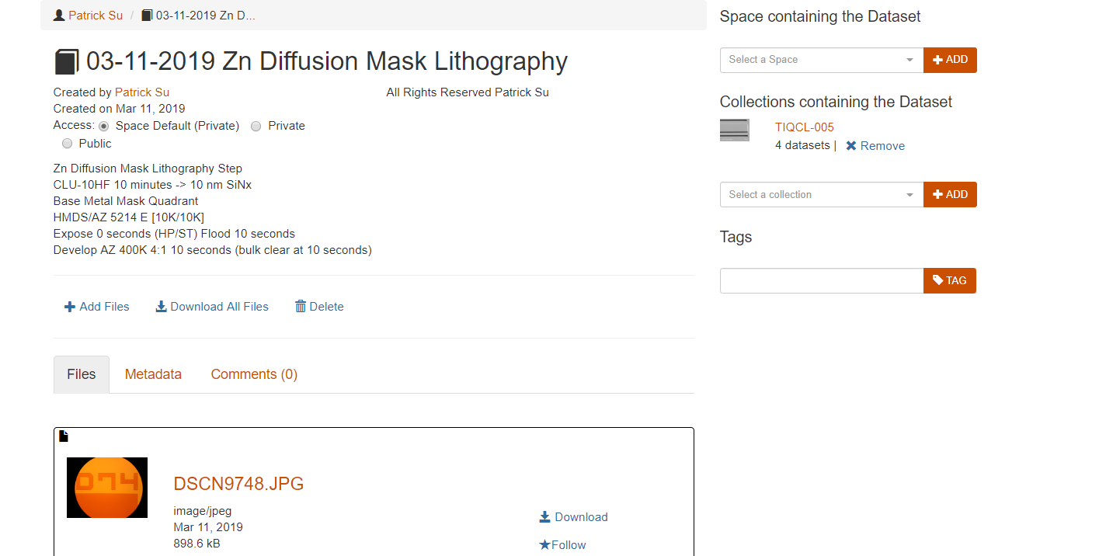
What is 4CeeD? Efficient Data Collection
Templates and Extractors for Rapid Storage
Notes:
When I’m finding data or looking at my groupmate’s notebooks
- Either illegible or unsearchable
- Really only understandable to the person who wrote them
- Called a “Notebook” and not a “Textbook”

Slide 8
What is 4CeeD? Efficient Data Collection
Templates and Extractors for Rapid Storage
Templates are stored as Metadata
Notes:
When I’m finding data or looking at my groupmate’s notebooks
- Either illegible or unsearchable
- Really only understandable to the person who wrote them
- Called a “Notebook” and not a “Textbook”

Slide 9
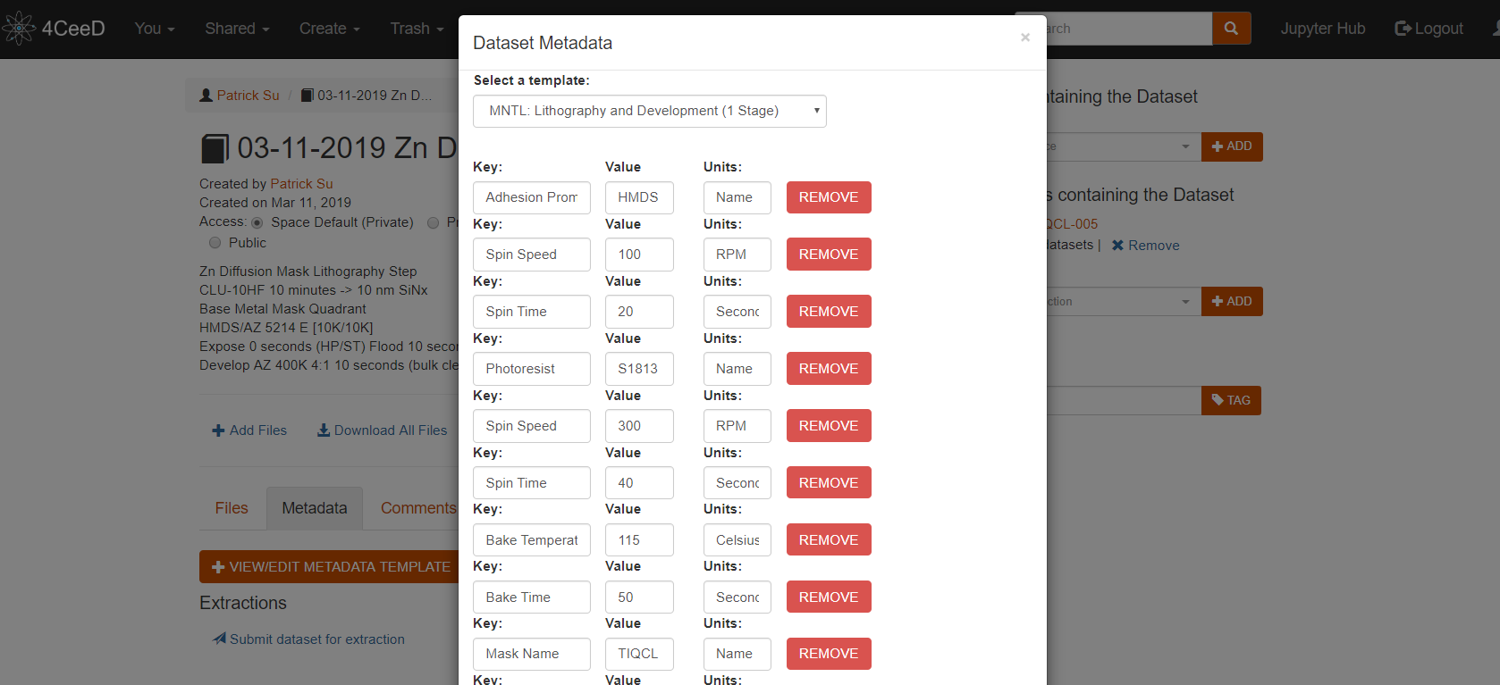
What is 4CeeD? Efficient Data Collection
Templates and Extractors for Rapid Storage
Stored Key -Value Pairs
Incredibly useful for Jupyter Integration
(Later Topic)
Notes:
When I’m finding data or looking at my groupmate’s notebooks
- Either illegible or unsearchable
- Really only understandable to the person who wrote them
- Called a “Notebook” and not a “Textbook”

Slide 10
Workshop Outline
What is 4CeeD?
New and Improved
A Clean and Intuitive GUI
Mobile App
Jupyter Integration
Exploring Jupyter Integration
Live Demo
Looking Forward to SENSELET
Questions and Feedback

Slide 11
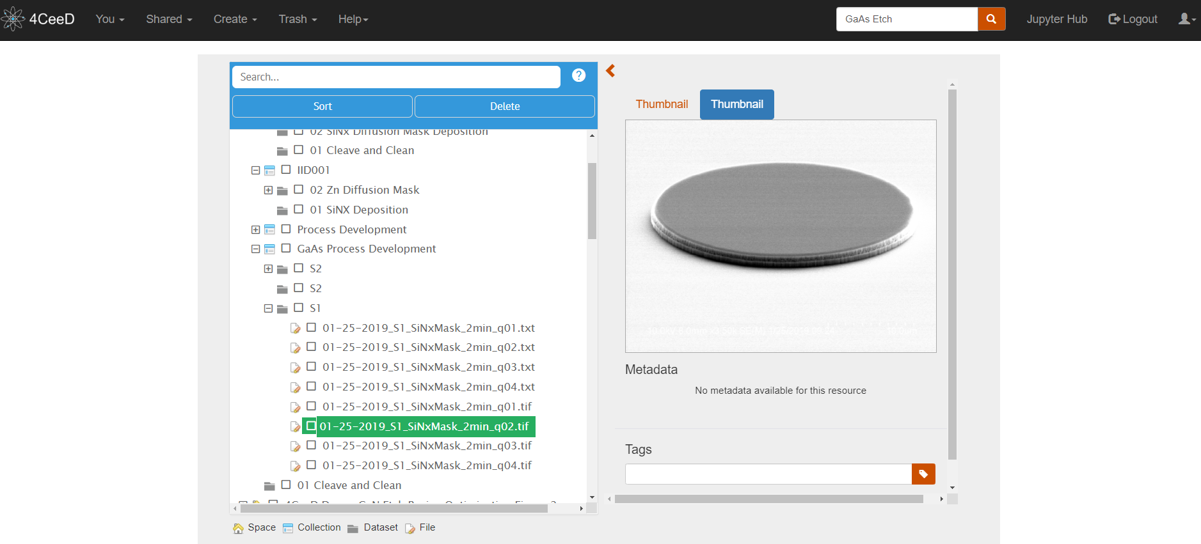
New and Improved An Intuitive GUI Dashboard
Dashboard View of the new GUI of 4CeeD
SEM Image Preview
File Tree Viewer
Notes:
Now here’s a dashboard of 4CeeD
- Immediately you can see I can access .tif images from my SEM
- Through a File Tree explorer that makes it intuitive and easy to navigate and use
- With a search bar at the top

Slide 12
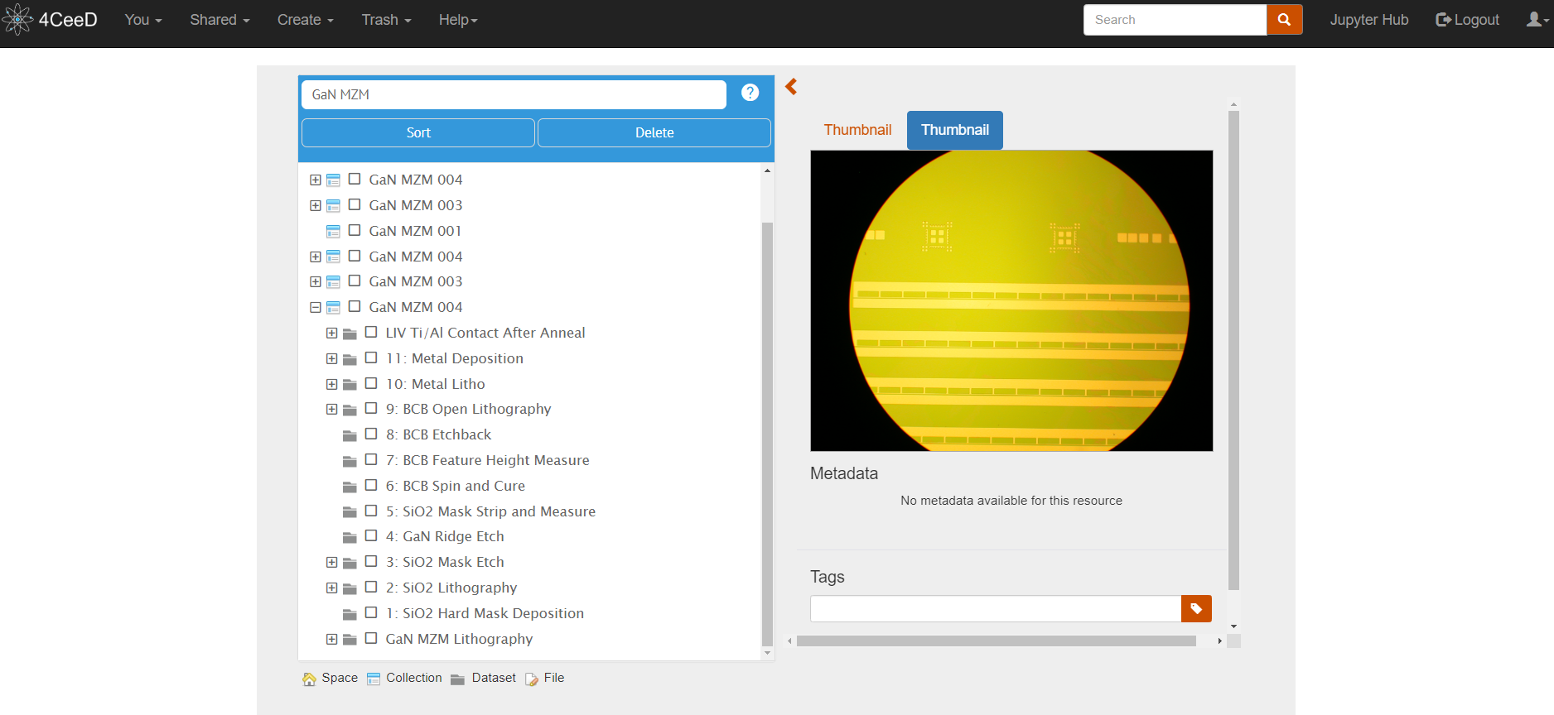
New and Improved An Intuitive GUI Dashboard
Searchable Data in Easy References and Places
GaN MZM Files Through Search Function
MZM Metallized Image Preview
Notes:
Here, you can see that I can easily search for any project and access it within seconds to find

Slide 13
New and Improved An Intuitive GUI Dashboard
Searchable Data in Easy References and Places
Fabrication Process Flow
MZM Metallized Image Preview
Notes:
Here, you can see that I can easily search for any project and access it within seconds to find

Slide 14
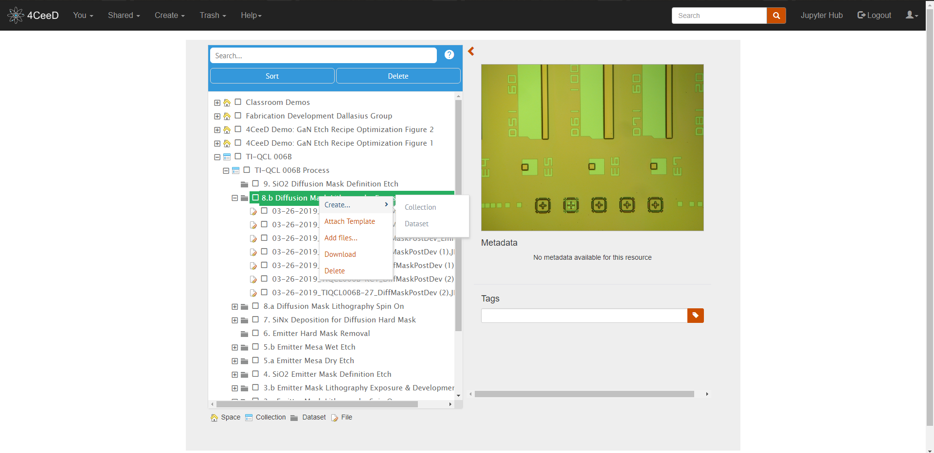
New and Improved An Intuitive GUI Dashboard
Manage Data Organization Quickly
Organize from a Menu
Know what You’re Working With at a Glance
Quickly Modify Data
Notes:
Here, you can see that I can easily search for any project and access it within seconds to find

Slide 15
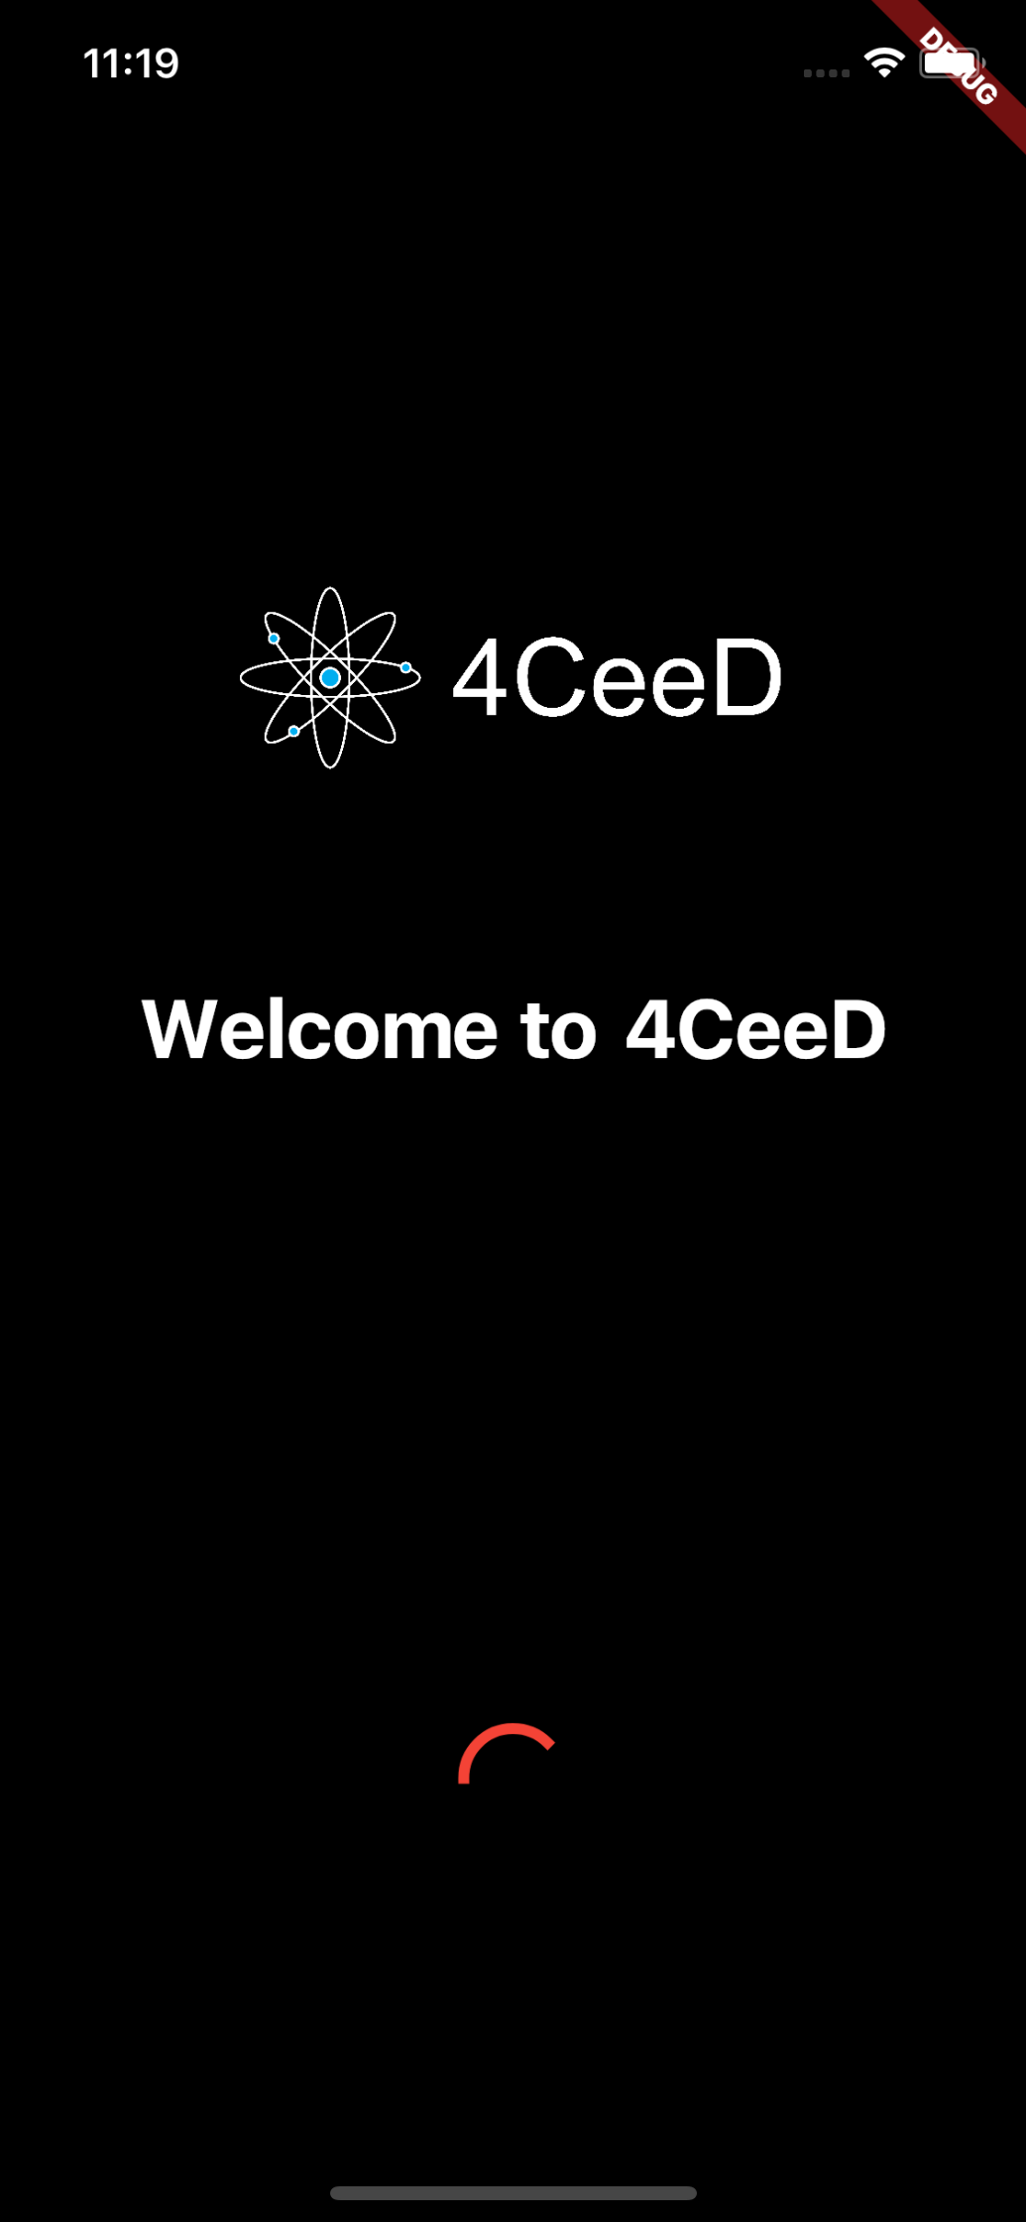
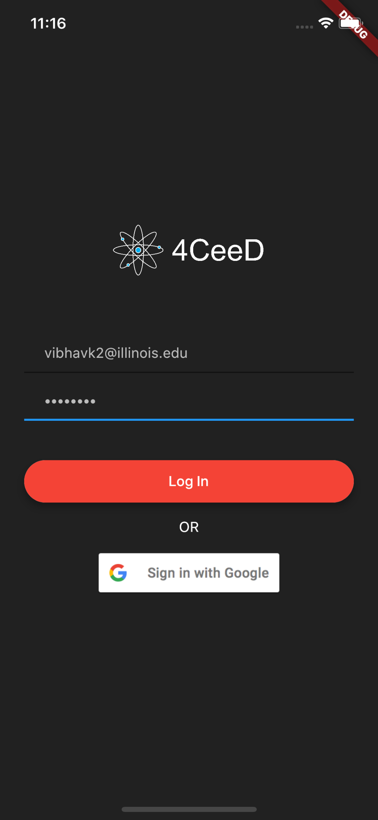
New and Improved 4CeeD Mobile App
Login page:
Supports local (ldap) and Google sign in
Splash Screen

Slide 16
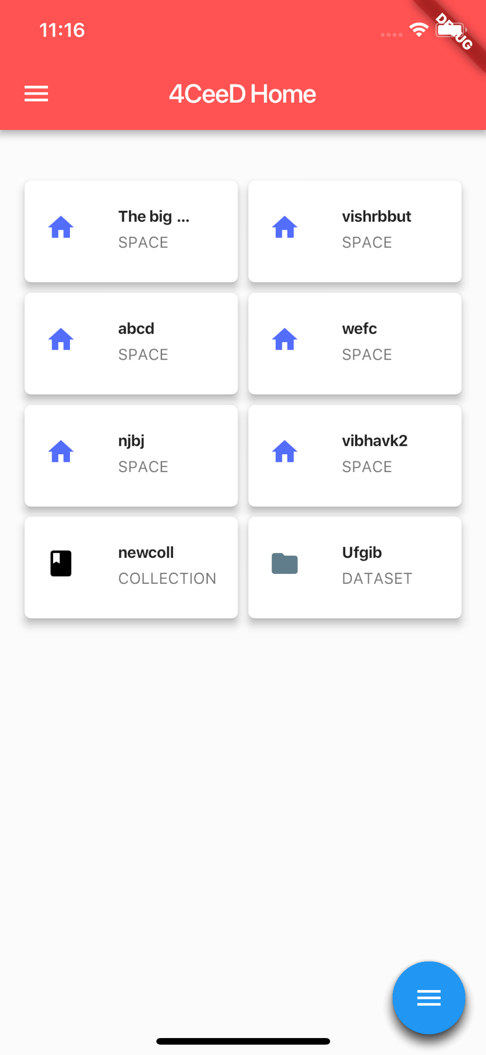
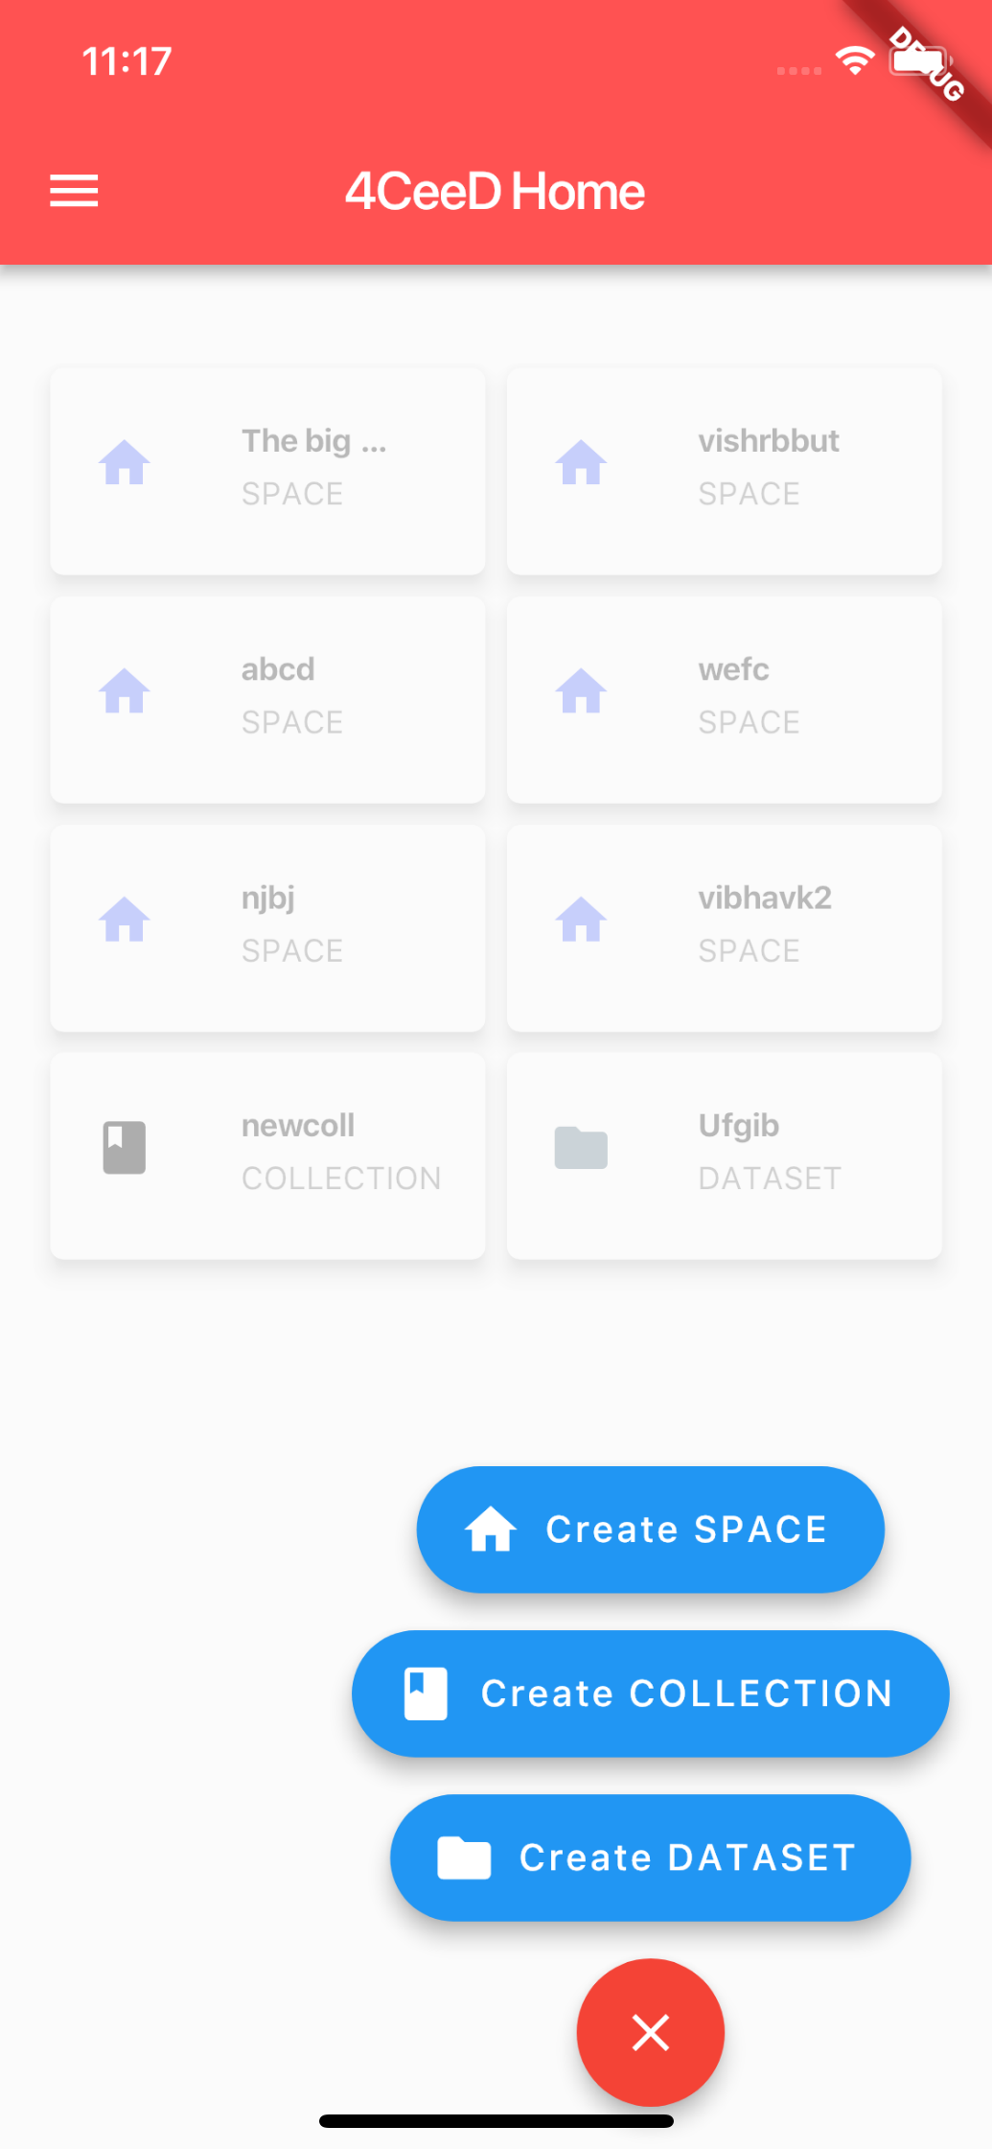
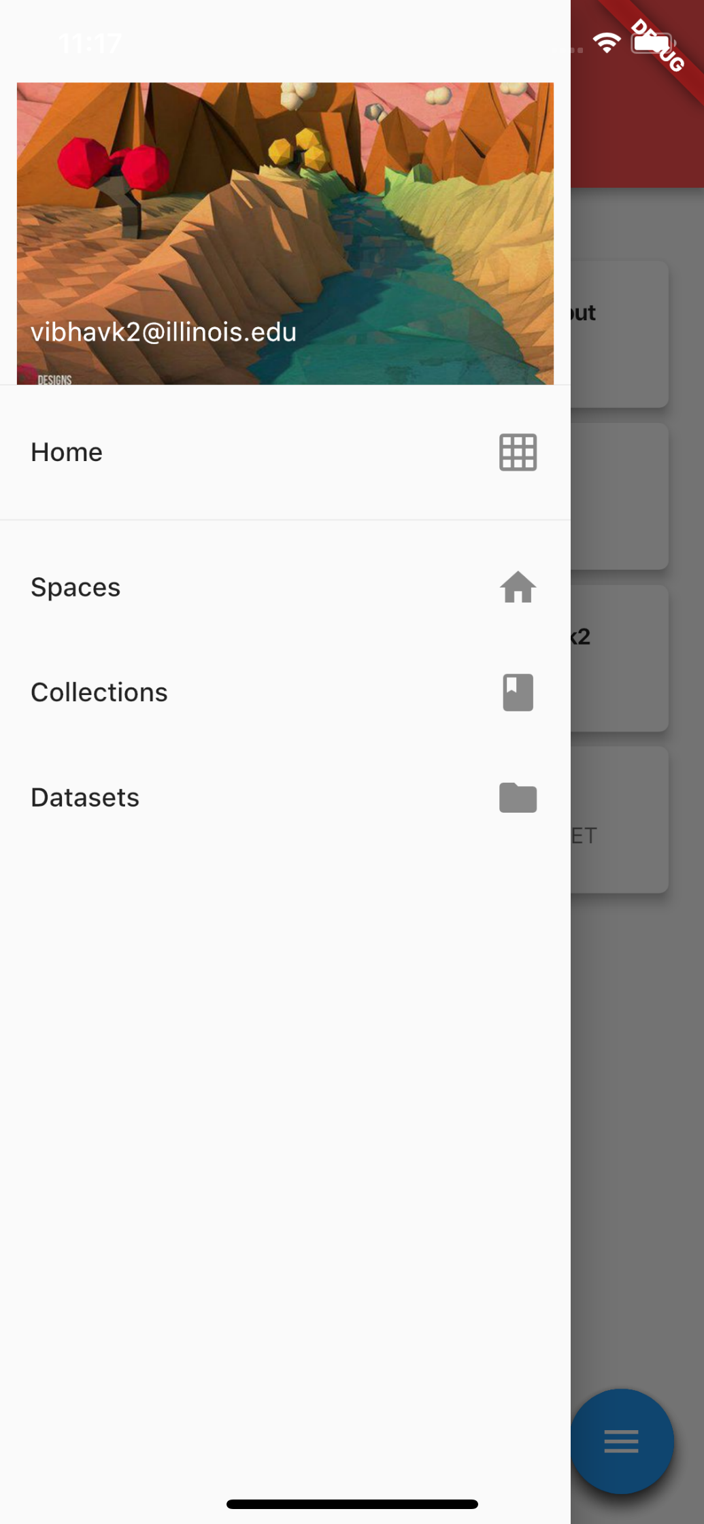
New and Improved 4CeeD Mobile App
Home Screen:
Root with action button
Action button functionality with animation
Drawer

Slide 17
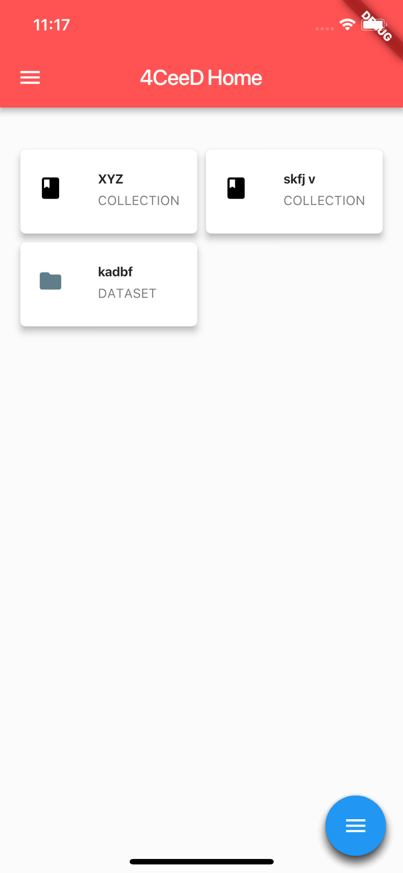
New and Improved 4CeeD Mobile App
By tapping any of the tiles, we can move to the next level
The action button changes relevance

Slide 18
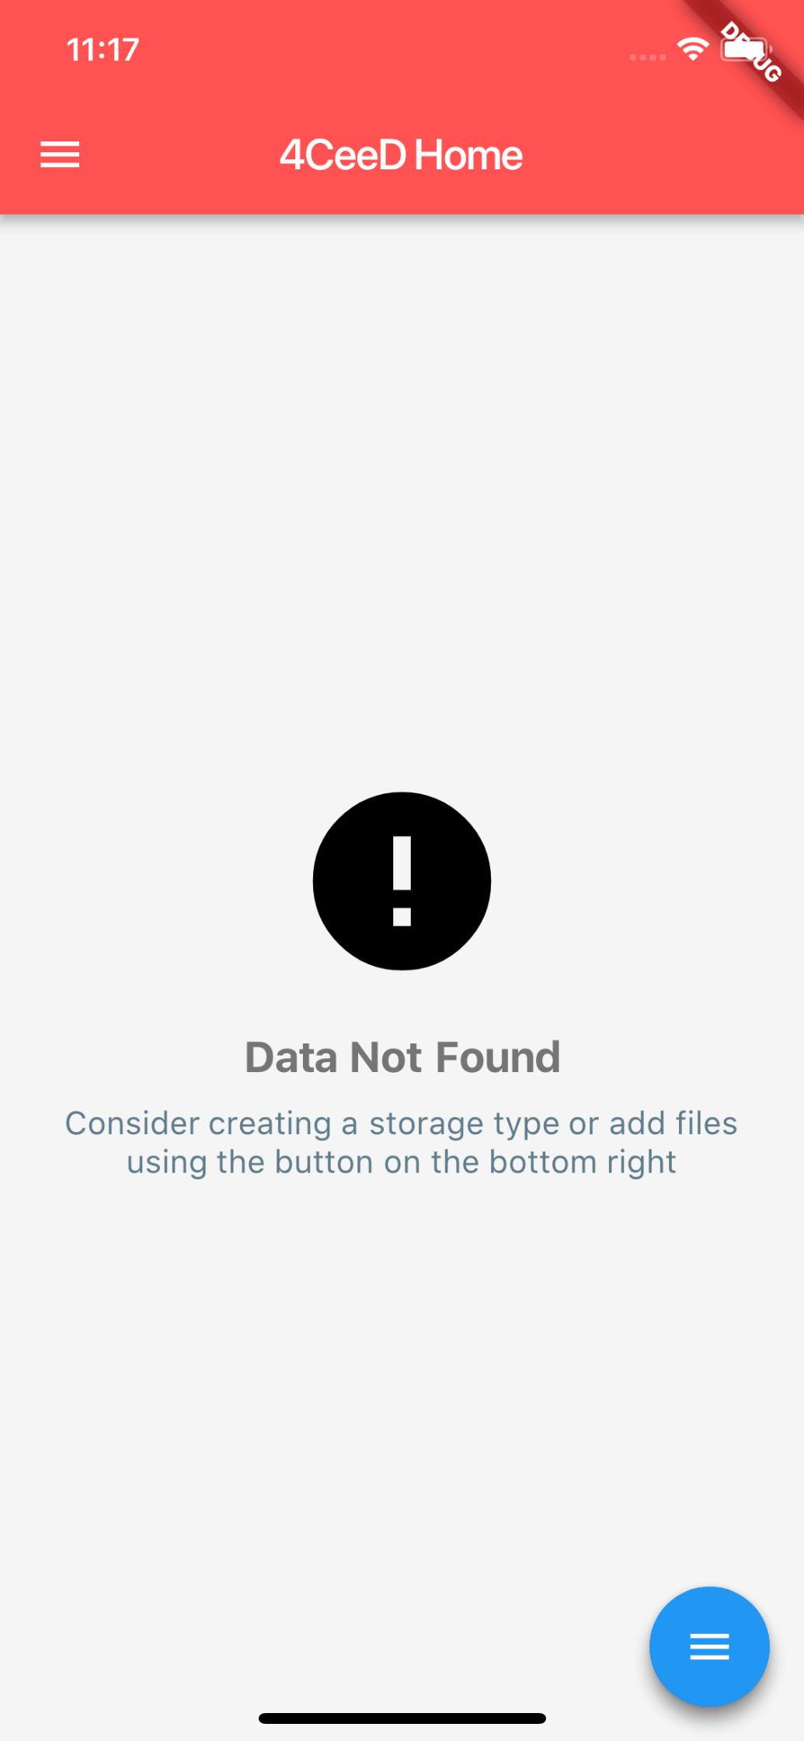
New and Improved 4CeeD Mobile App
Inside a dataset, the action button changes relevancy to “Upload Files”
If a space/collection/dataset is empty, the page shows:

Slide 19
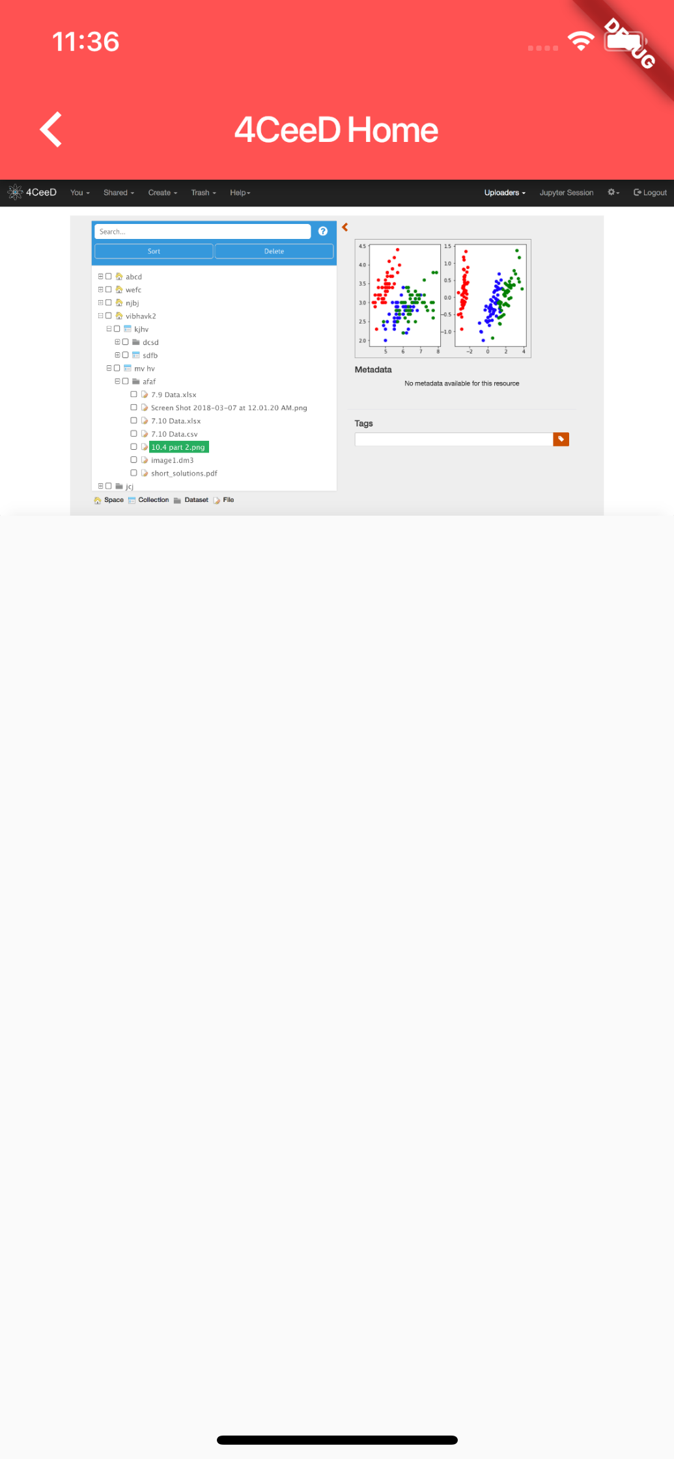
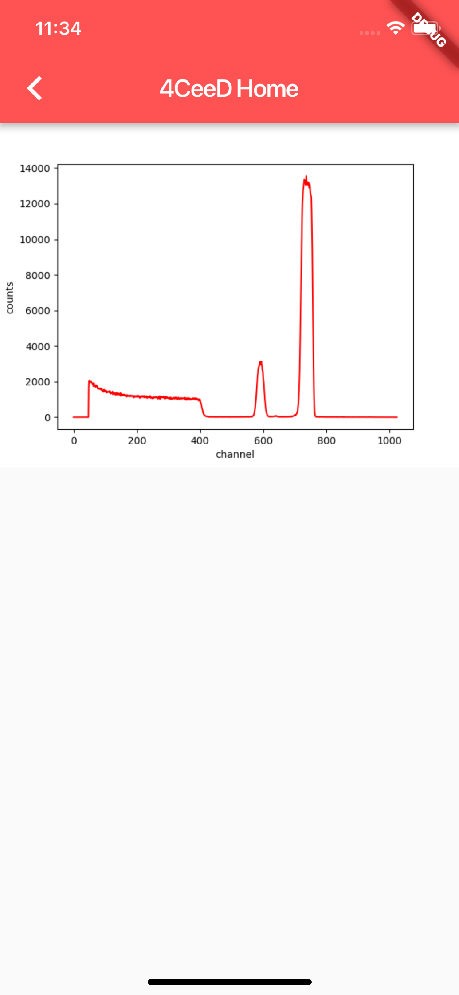
New and Improved 4CeeD Mobile App
Previews for files
.png file
.spe file

Slide 20
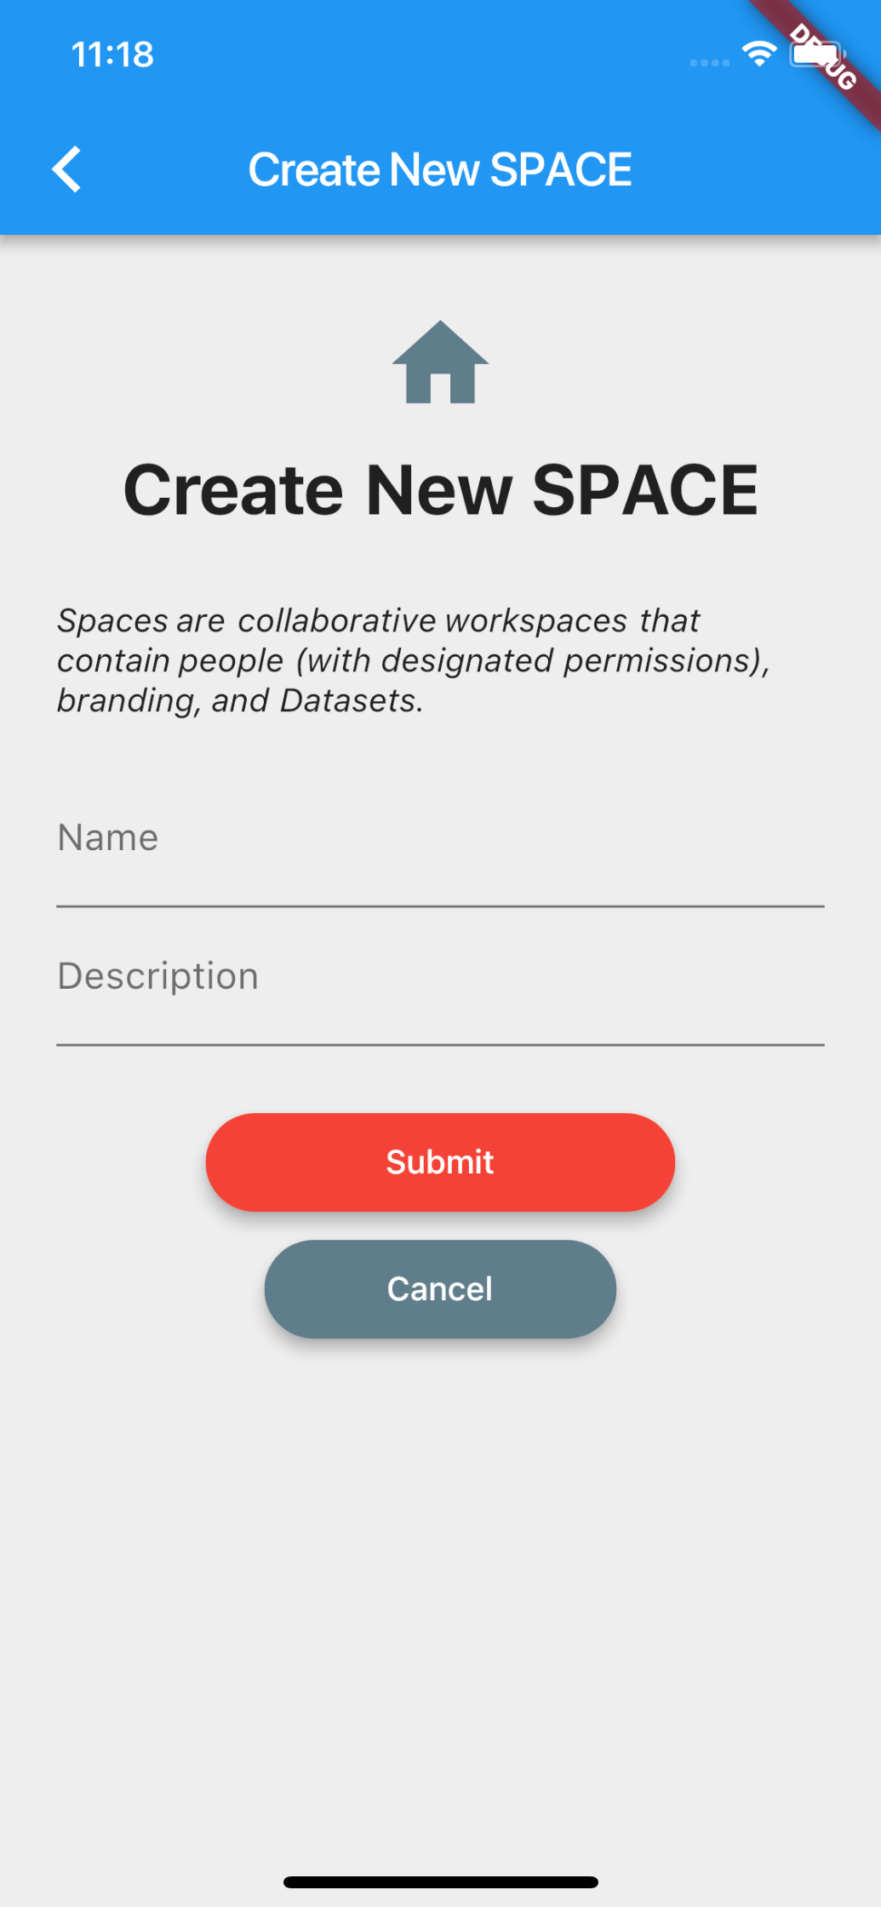
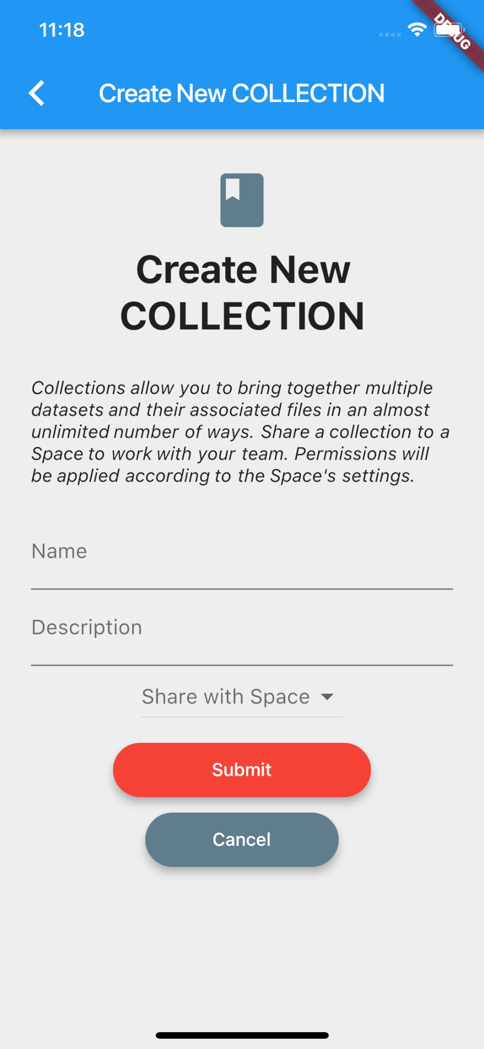
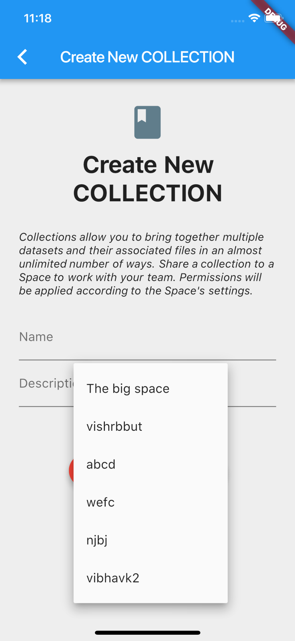
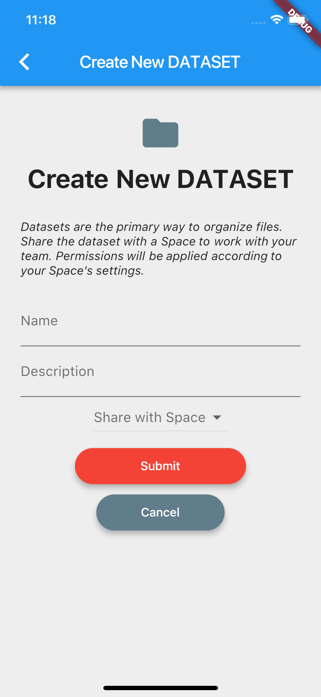
New and Improved 4CeeD Mobile App
Create Space
Create Collection/Dataset with dropdown menu

Slide 21
New and Improved 4CeeD Mobile App
Upload files
The button would open the camera. The page would also allow selection of images from phone gallery

Slide 22
Workshop Outline
What is 4CeeD?
New and Improved
Exploring Jupyter Integration
Rapid Visualizations
Portable Analysis
Live Demo
Looking Forward to SENSELET
Questions and Feedback

Slide 23
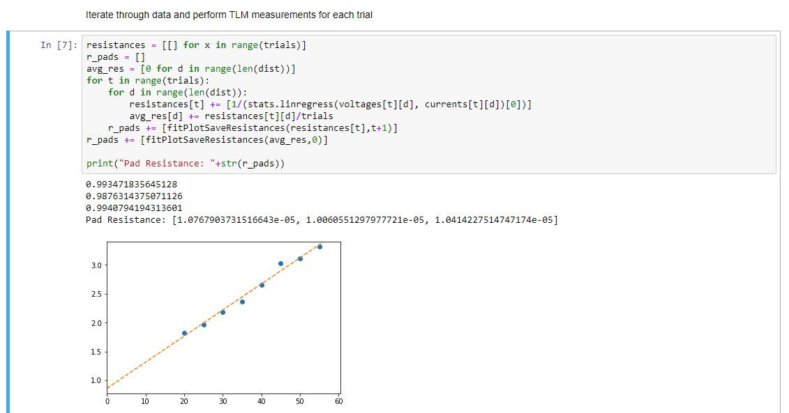
Jupyter Integration What is Jupyter Notebook?
Jupyter Notebook is an open-source web application that allows for quick data analysis and visualization
Supports a variety of programming languages but is commonly used with Python
https://jupyter.org/

Slide 24
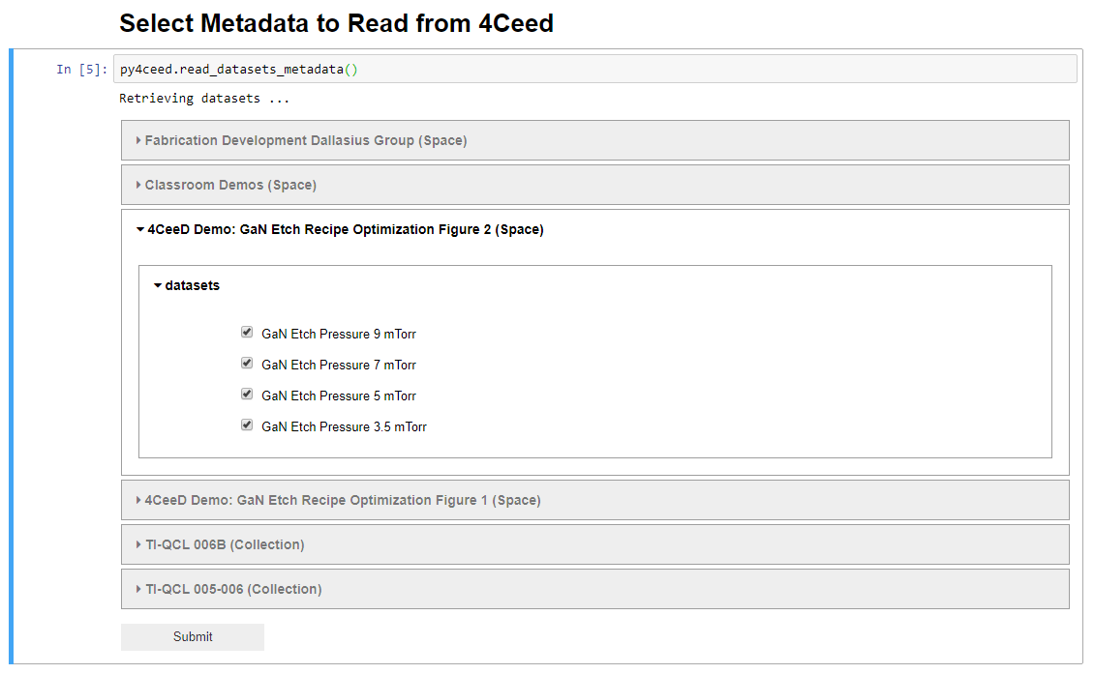
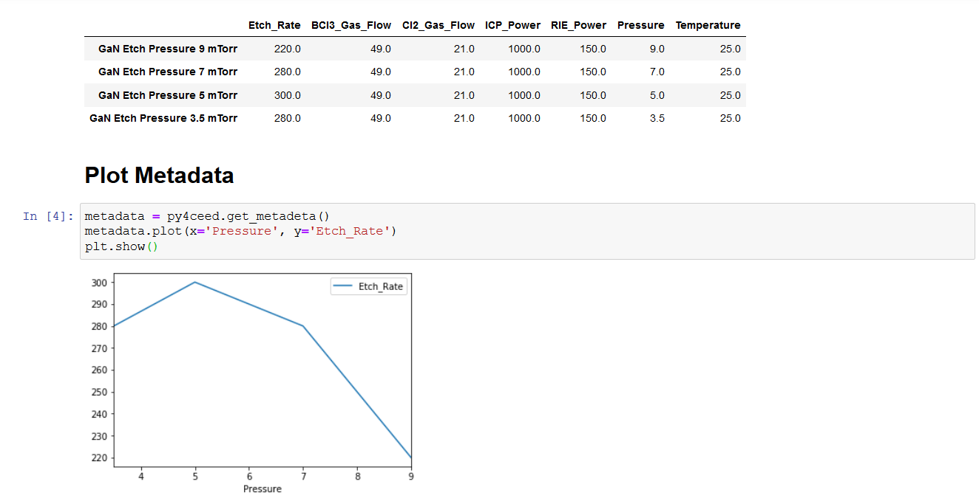
Jupyter Integration Integration with 4CeeD
Access metadata from datasets
Uses pandas tables to store info
Create custom columns
Easy data retrieval and sorting
Quick plotting through matplotlib
https://t2c2.csl.illinois.edu/jupyter-tutorial/

Slide 25
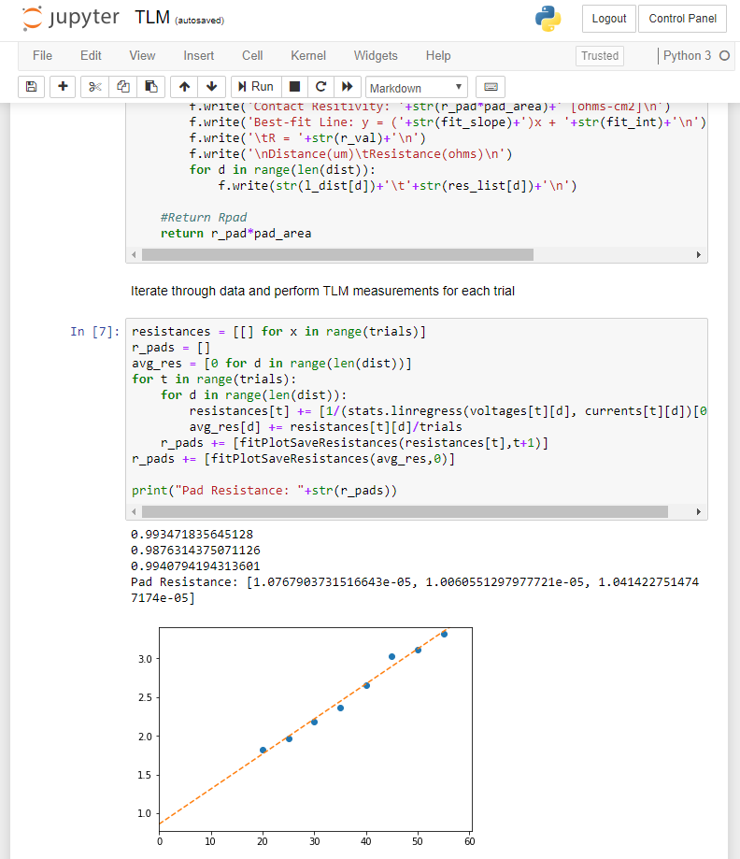
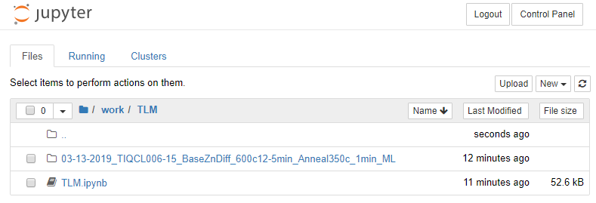
Jupyter Integration Portable Analysis
Jupyter environment is hosted on 4CeeD servers
Allows for remote access and processing of custom scripts

Slide 26
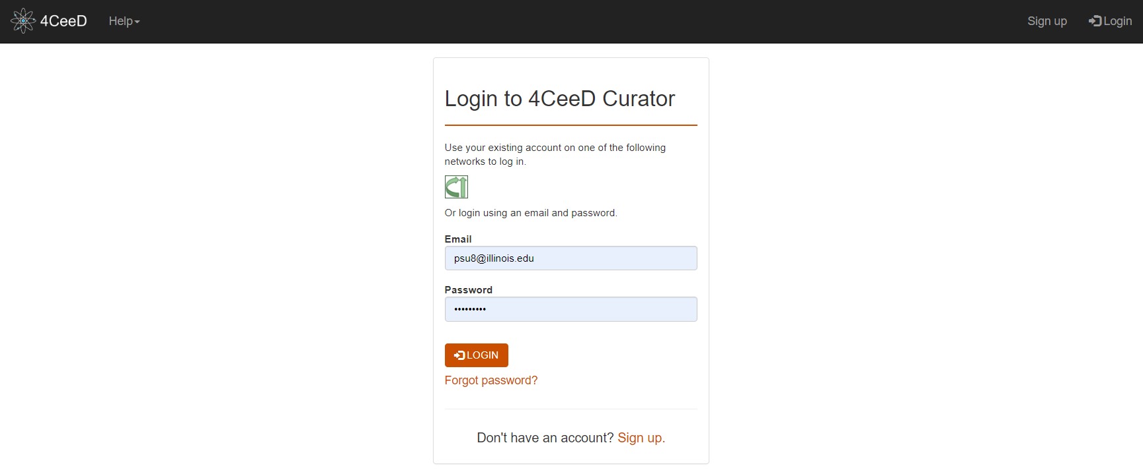
Live Workshop Demo
A demonstration of 4CeeD functions
Walkthrough of how to use Jupyter on 4CeeD
An example of portable data processing with Jupyter
4ceed.Illinois.edu

Slide 27
Workshop Outline
What is 4CeeD?
New and Improved
Live Demo
Exploring Jupyter Integration
Looking Forward to SENSELET
Knowing Your Processing Environment
Questions and Feedback

Slide 28
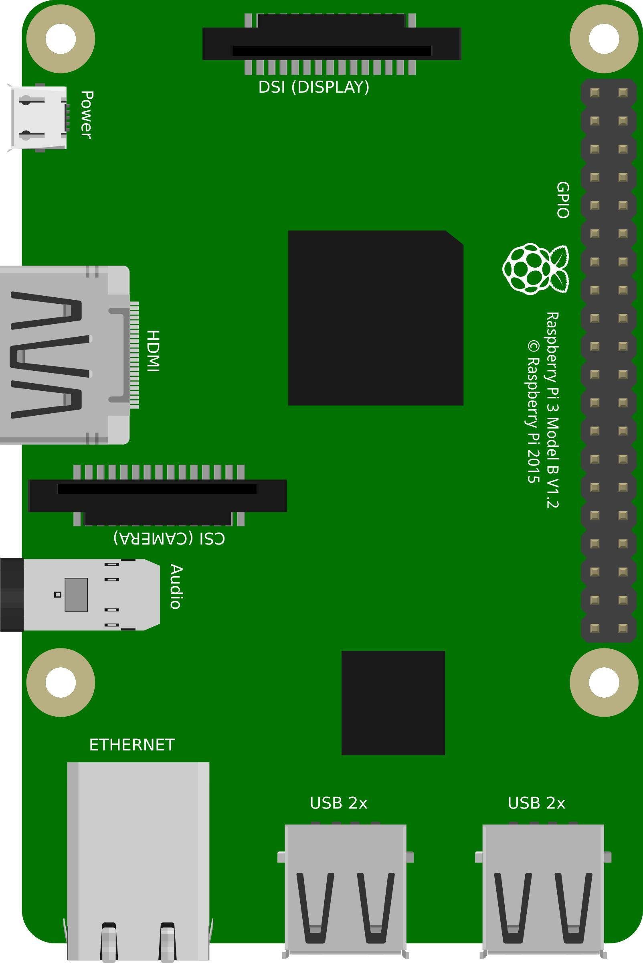
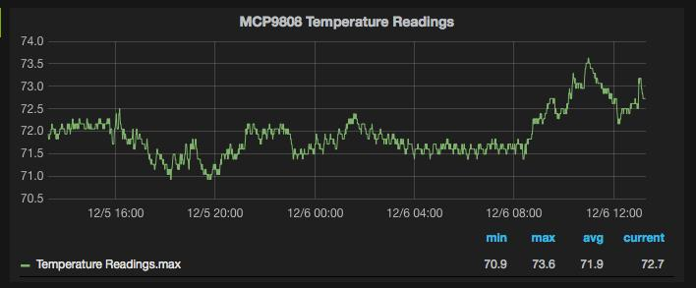
SENSELET What is SENSELET
A system of wireless, automated sensors that monitor the cleanroom environment
Future plans to integrate with 4CeeD to automatically provide greater insight into process parameters
Senselet
4CeeD
Researchers
SenseCloud
Lab Administrators
Senselet
Notes:
Here, you can see that I can easily search for any project and access it within seconds to find

Slide 29
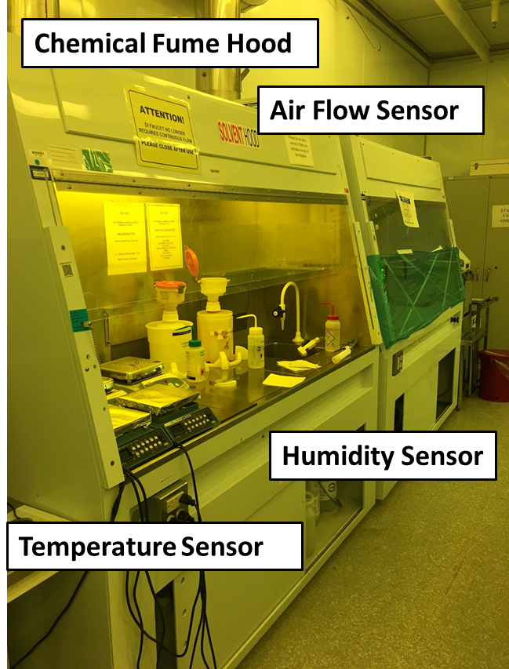
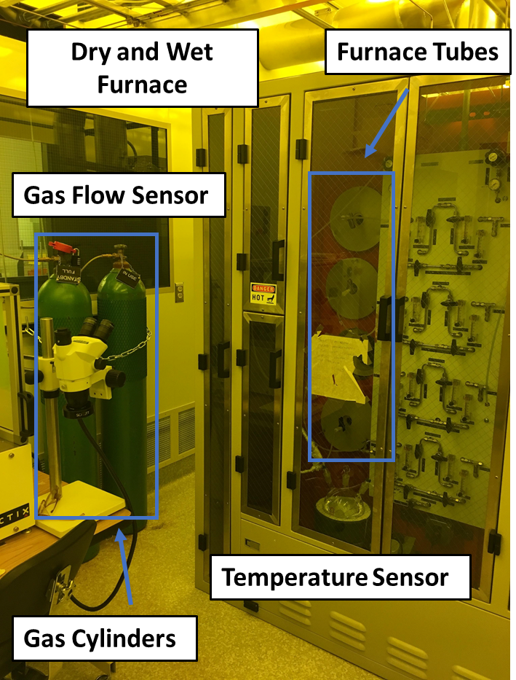
SENSELET Environment Logging
Automatically log/track humidity, temperature, gas flows, etc.
Notes:
Here, you can see that I can easily search for any project and access it within seconds to find

Slide 30
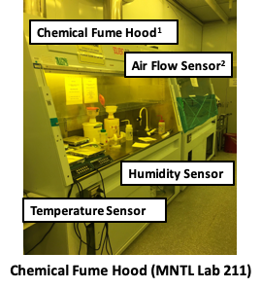
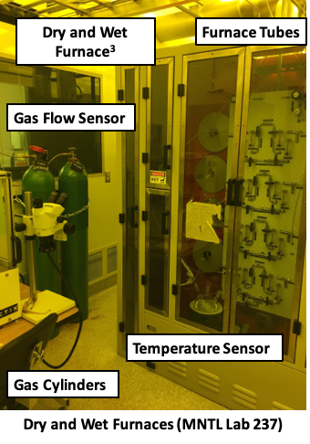
SENSELET Environment Logging
SENSELET automatically records data available for 4CeeD users
Senselet
4CeeD
Researchers
SenseCloud
Lab Administrators
Senselet

Slide 31
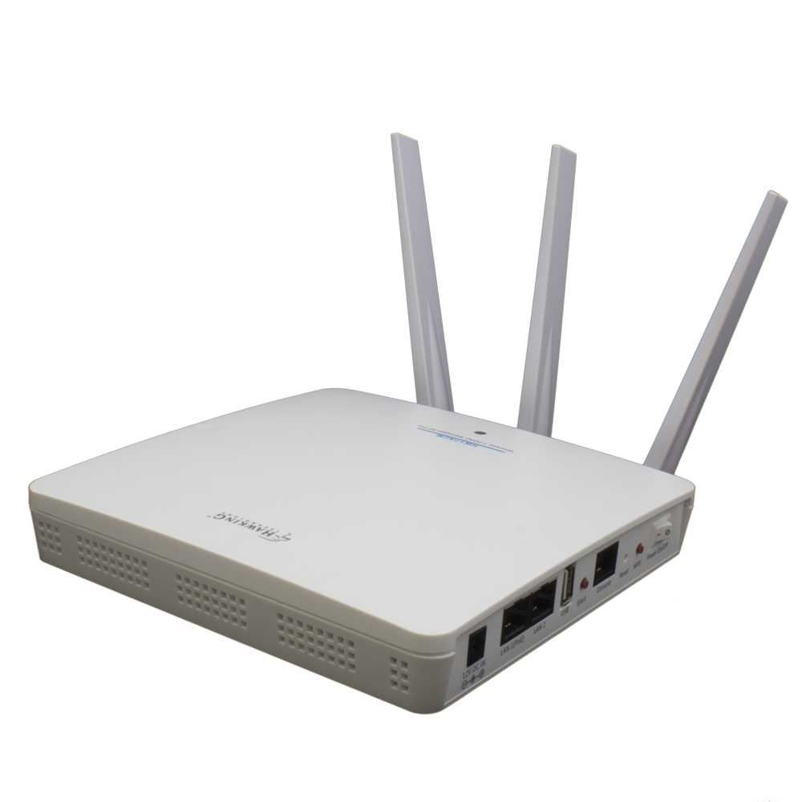
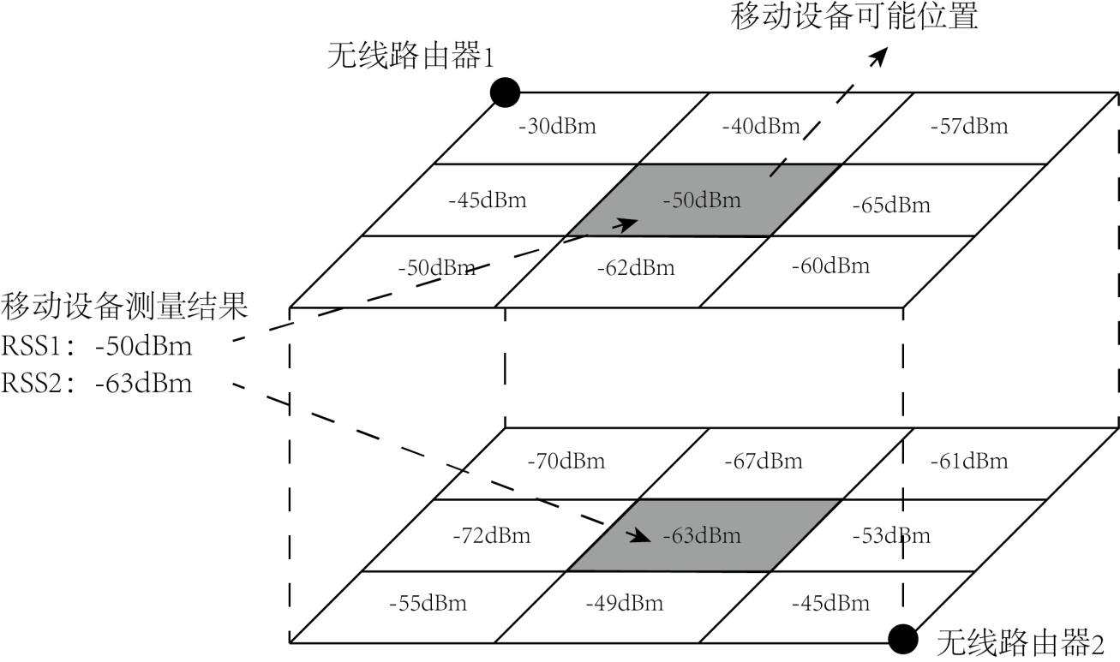
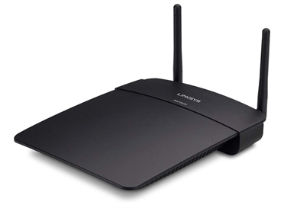
SENSELET Wifi-RSS Localization for Improved Logging
Potential Position
Access Point 1
Measurement result on cellphone
RSS1: -52 dBm
RSS2: -60 dBm
Access Point 2
Localization of cleanroom users for automatic logging of specific rooms
Notes:
Here, you can see that I can easily search for any project and access it within seconds to find

Slide 32
Thank You for joining the MNTL 4CeeD Workshop!
Notes:
- My name is Patrick Su and I’m a graduate student at the micro and nanotechnology lab
I work primarily on active semiconductor devices such as lasers and optical modulators
throughout the course of my research, I have been using 4CeeD to organize and share data within my research group
If you’re like me or my group, before 4CeeD, we were limited to using Google Drive, Dropbox, or OneDrive to store and share our data
- Using a cloud system that was not built to support our needs:
- No easy way of storing recipes. No easy way to preview data except downloading and opening. Nothing is “Searchable”. I can’t type in 500 C diffusion and get all of the files that ever have that

Slide 33
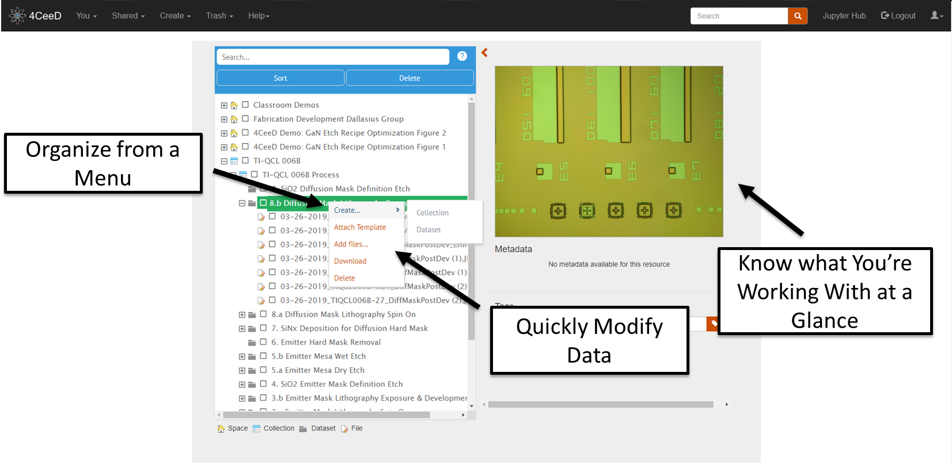
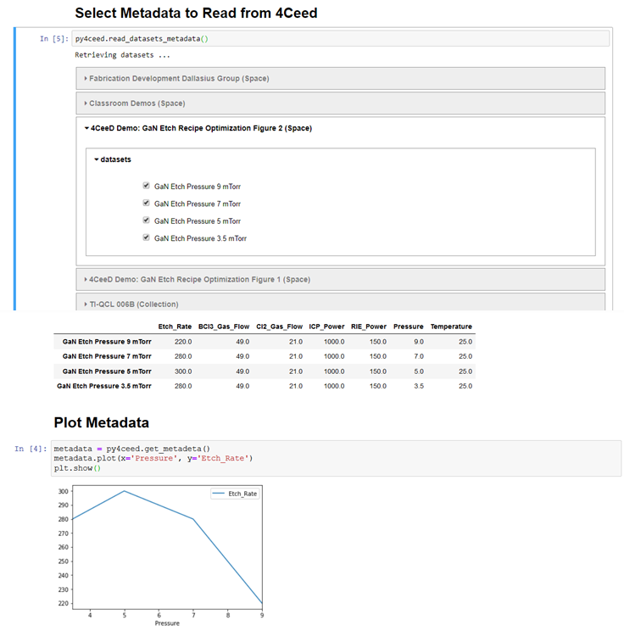
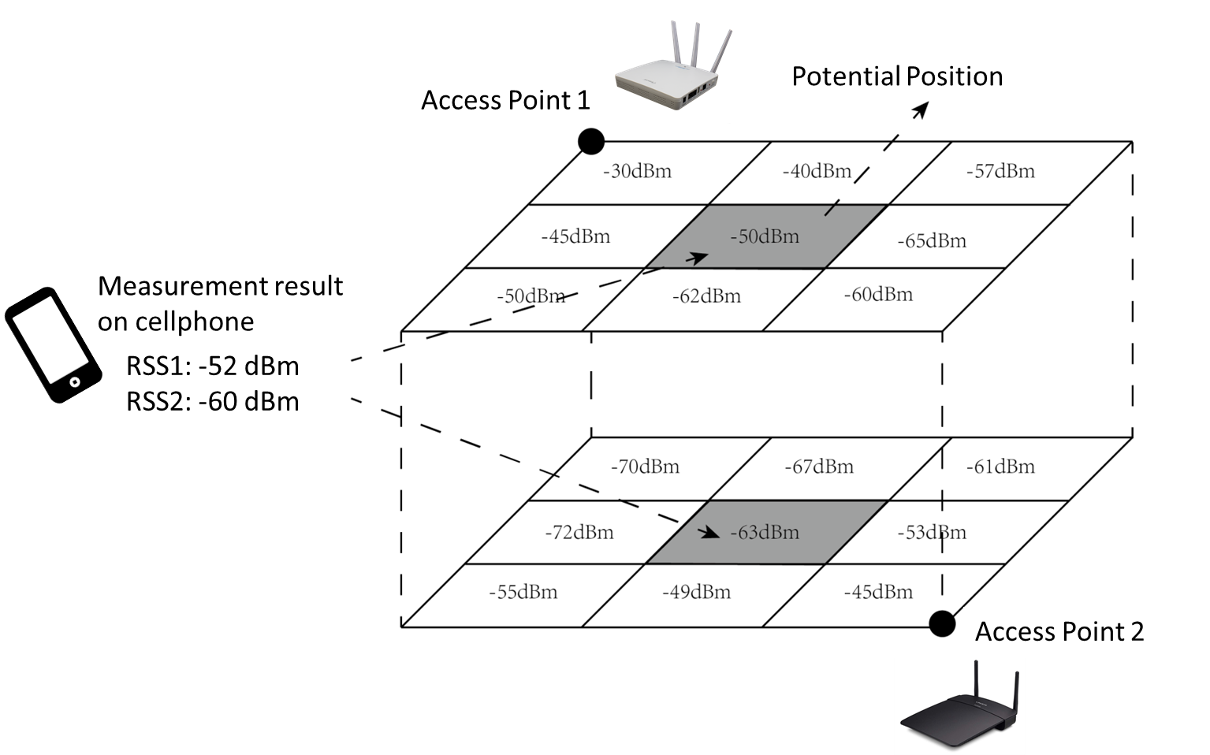
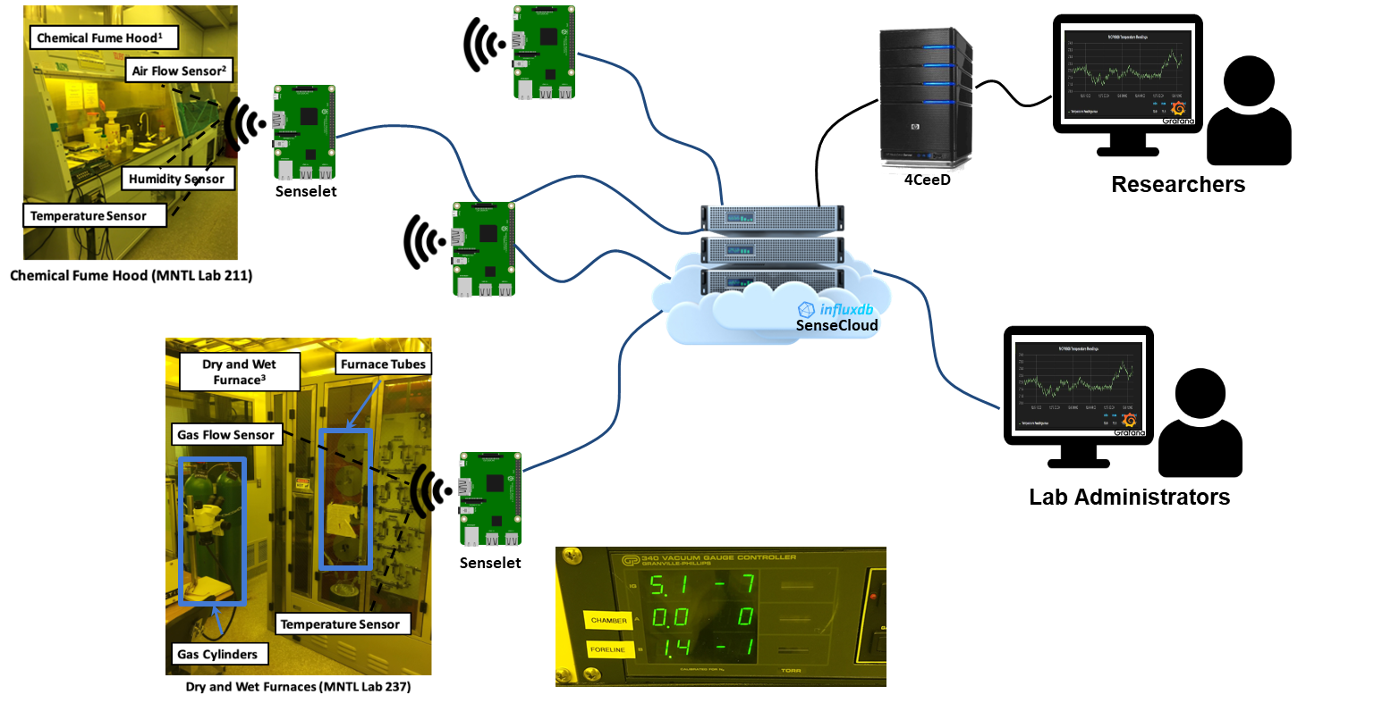
Questions/Feedback?
Notes:
- My name is Patrick Su and I’m a graduate student at the micro and nanotechnology lab
I work primarily on active semiconductor devices such as lasers and optical modulators
throughout the course of my research, I have been using 4CeeD to organize and share data within my research group
If you’re like me or my group, before 4CeeD, we were limited to using Google Drive, Dropbox, or OneDrive to store and share our data
- Using a cloud system that was not built to support our needs:
- No easy way of storing recipes. No easy way to preview data except downloading and opening. Nothing is “Searchable”. I can’t type in 500 C diffusion and get all of the files that ever have that

